Slide 1
The Spectrum Viewer: A Closer Look

Slide 2
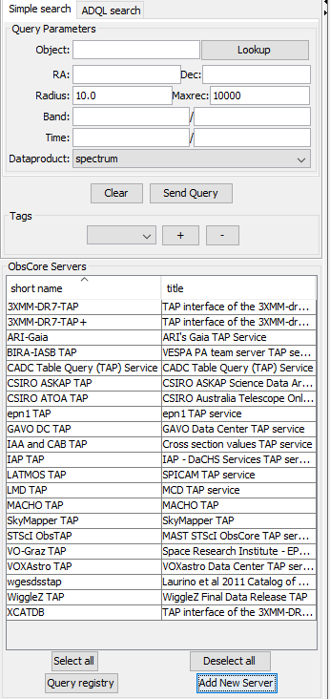
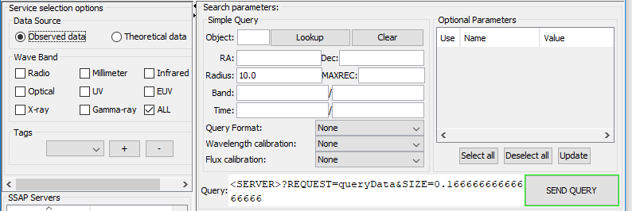
SPLAT-VO(theoretical)
Data source:
Local file
VO(SSAP query)
ObsCore TAP(similar to casjob)

Slide 3
Processing/plotting spectra
Binary/Constant math
Pan/cut and zoom/scale
Polynomial fitting
Fitting standard profile models
Flip/shift/redshift spectrum
Various kind of filters
Also about to handle 2D and 3D data

Slide 4
Specview
File Source and format
Local file/remote locations
Webservice(discontinued)
VO
Able to filter out flagged anomality data point
Plot ability(1D only)
Co-plotting: automatic compatibility check
Combining and process:
Scale, offset and trim
Resample
Splice/coadd
Rectify
Filter: only box filter and Brault& White filter

Slide 5
Specview continue’
Fitting models
Line identification
Compare data with standard template
Manually measure data

